Slide 1
Emory Math Circle

Slide 2
Rules for Math Circle
What do you think think the rules should be?
Type your answer in the chat!

Slide 3
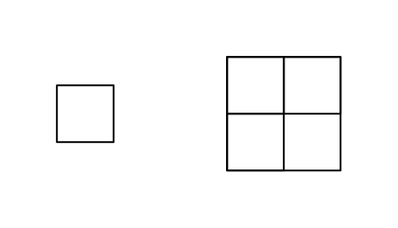
Counting Squares

Slide 4
What is a square?

Slide 5
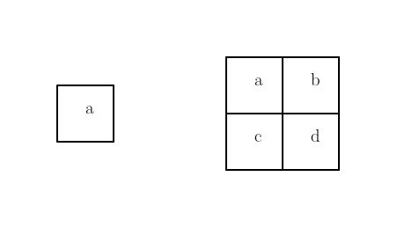
How many squares can you see?

Slide 6
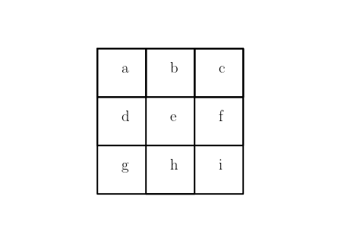
Count Squares
Number of 1 by 1 squares
Number of 2 by 2 squares
Number of 3 by 3 squares

Slide 7
Breakout Rooms!

Slide 8
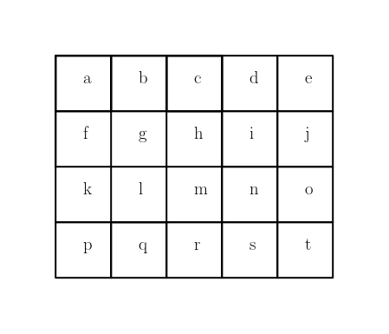
Count Squares Number of 2 by 2 squares?
Number of all squares?
Notes:
There are 20 + 12 + 6 + 2 = 40 squares!

Slide 9
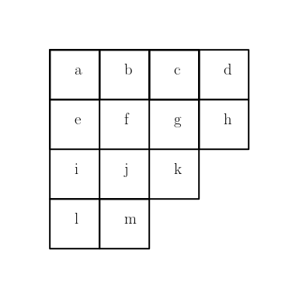
Let’s Get Creative!
Number of 1 by 1 squares
Number of 2 by 2 squares
Number of 3 by 3 squares
Notes:
There are 13 + 6 + 1 = 20 squares!

Slide 10
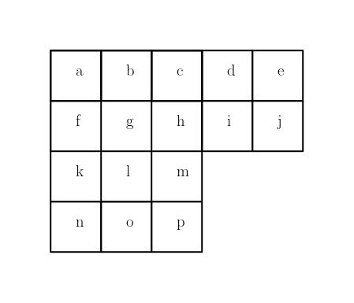
Notes:
There are 16 + 8 + 2 = 26 squares!

Slide 11
Challenge
Count the Rectangles!
Notes:
There are (4+3+2+1) * (5+4+3+2+1) = 10 * 15 = 150 rectangles!

Slide 12
Count Triangles

Slide 13
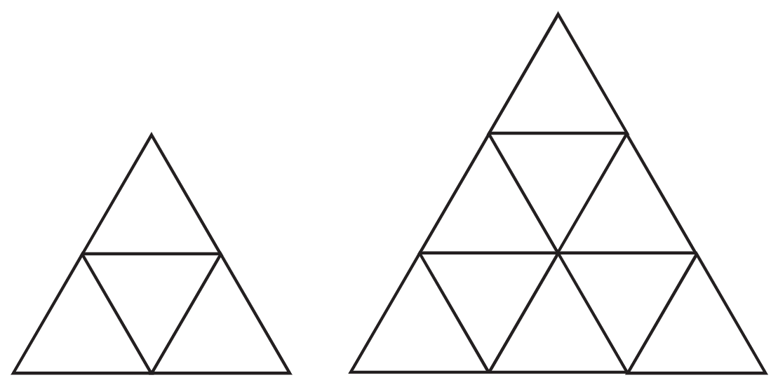
How many triangles can you see?
Don’t forget upside down triangles!
Notes:
There are 4+1 = 5 triangles and 9 + 3 + 1 = 13 triangles, respectively!

Slide 14
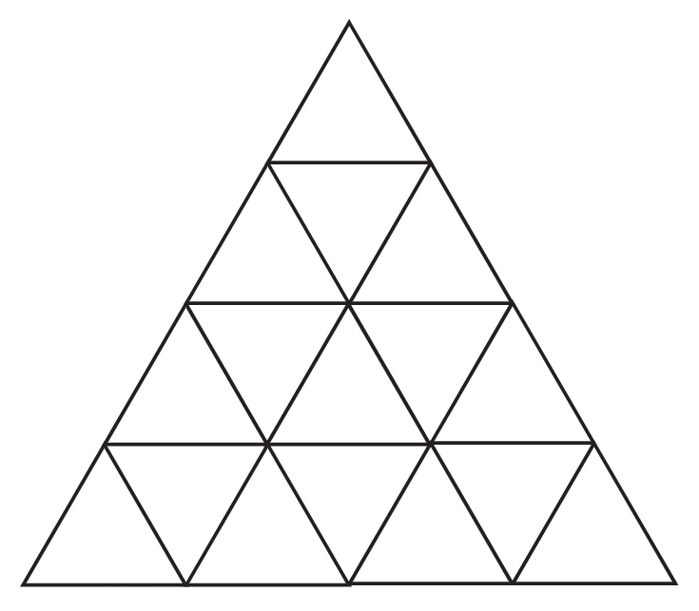
Bigger Triangle? No Problem!
Notes:
There are 16 + 7 + 3 + 1 = 27 triangles!

Slide 15
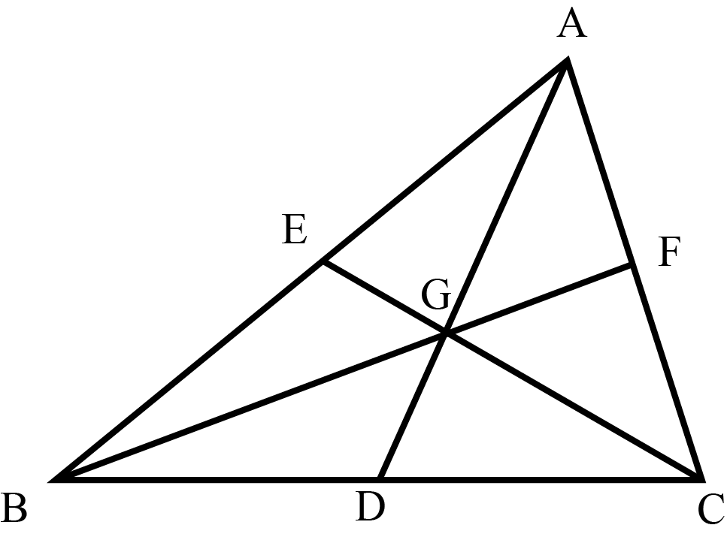
Challenge
How many triangles appear when we make three cuts through the middle of a triangle?
Notes:
There are 6 + 3 + 6 + 0 + 0 + 1 = 16 triangles!

Slide 16
Count Cubes

Slide 17
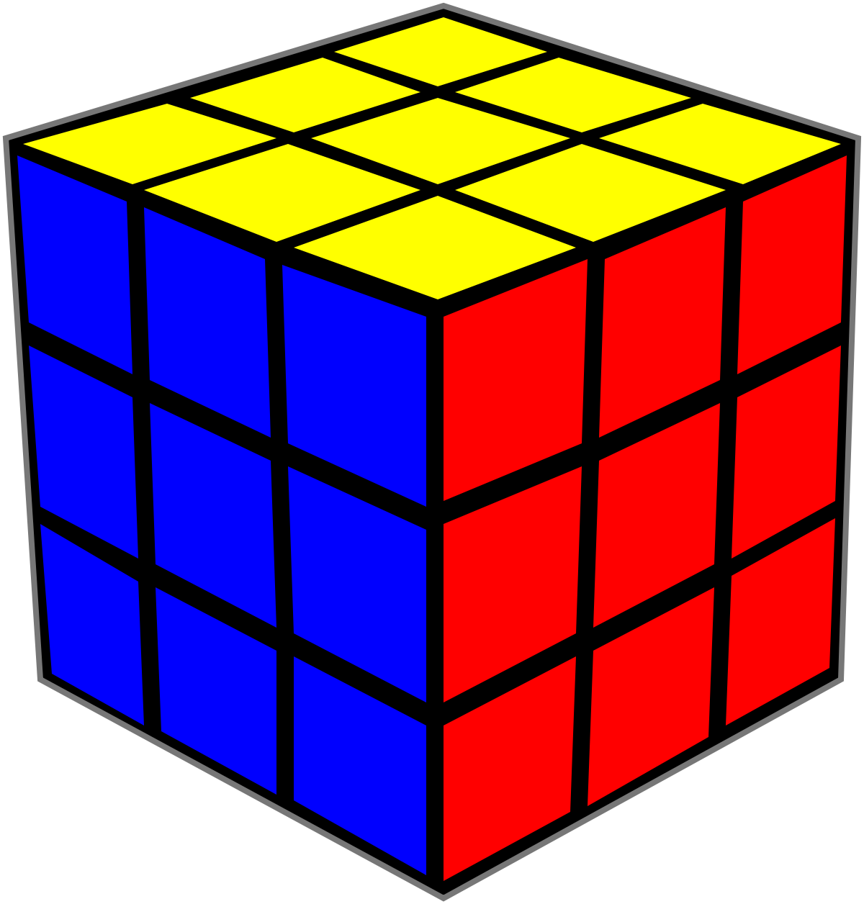
How many cubes are in a Rubix Cube?
Notes:
There are 1^3 + 2^3 + 3^3 = (1+2+3)^2 = 36 cubes!

Slide 18
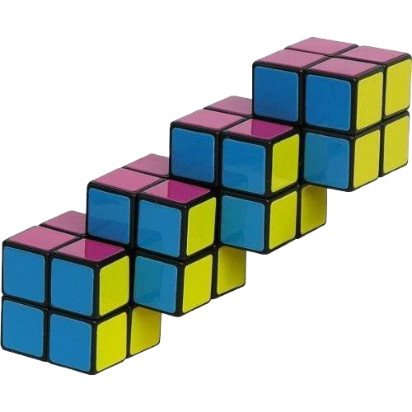
Weird Cube
How many cubes are in this strange Rubix Cube?
Notes:
There are 8+7*3 + 4 = 25 cubes!

Slide 19
Challenge
How many rectangular prisms are in a rubix cube?
(Hint: It’s a lot!)
Notes:
There are 36 cubes, and uh… a lot more? Can you figure it out?
There should be (3+2+1)^3 = 216

Slide 20
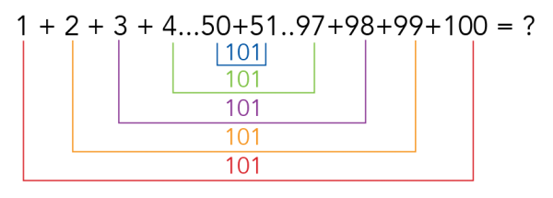
Fun Counting Story

